Slide 1
Class-II
(Operator Precedence, Associativity, conditional statements, Loop statements)

Slide 2
Objective of the course
To introduce the essential skills for a logical thinking to solve the problems
To introduce the essential skills in programming for solving the problems using computers

Slide 3
Procedure to be followed
Introducing the concept/construct in a programming language through a problem
Step 1 : Description of the problem
Step 2 : Understanding the problem
Step 3 : Analyzing the different approaches to solve the problem
Step 4 : Choosing an appropriate approach
Step 5 : Writing the required pseudocode/ﬂowcharts
Step 6 : Test for sample inputs
Step 7 : Write the relevant Code with suitable constructs with proper syntax and semantics
Step 8 : Compile and debug
Step 9 : Validate the test cases
Step 10: Execute and arrive at the solution.

Slide 4
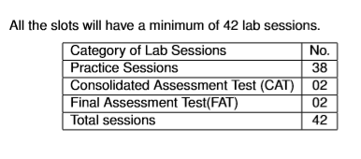
Plan of Lab sessions

Slide 5
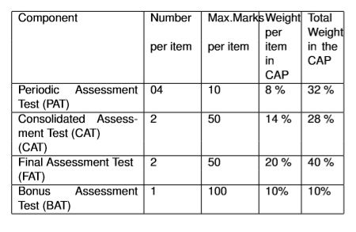
Continuous Assessment Process(CAP)

Slide 6
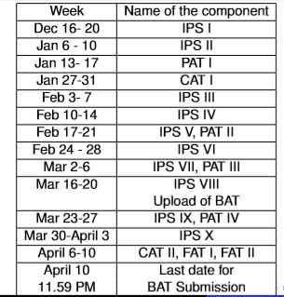
Schedule of IPS/PAT/CAT

Slide 7
Eligibility for FAT I & FAT II
A minimum of 75% of attendance at the end of April 3, 2020.

Slide 8
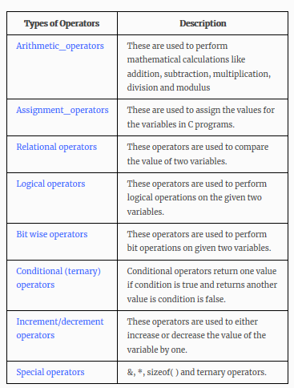
Operators

Slide 9
Operators Precedence and Associativity are two characteristics of operators that determine the evaluation order of sub-expressions in absence of brackets

Slide 10
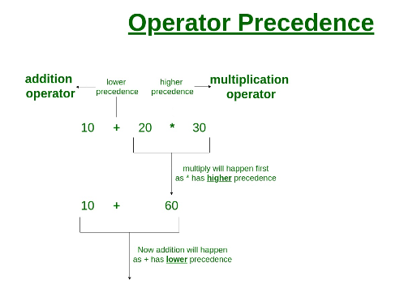
Operator Precedence
Operator precedence determines which operator is performed first in an expression with more than one operators with different precedence.

Slide 11
Operator Associativity
Operators Associativity is used when two operators of same precedence appear in an expression. Associativity can be either Left to Right or Right to Left.
For example: ‘*’ and ‘/’ have same precedence and their associativity is Left to Right, so the expression
“100 / 10 * 10” is treated as “(100 / 10) * 10”.

Slide 12
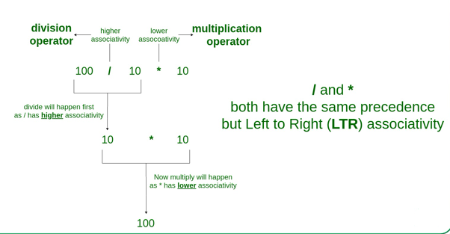
Example

Slide 13
Operator | Description | Associativity
( ) [ ] . -> ++ — | Parentheses (function call) (see Note 1) Brackets (array subscript) Member selection via object name Member selection via pointer Postfix increment/decrement (see Note 2) | left-to-right
++ — + – ! ~ (type) * & sizeof | Prefix increment/decrement Unary plus/minus Logical negation/bitwise complement Cast (convert value to temporary value of type) Dereference Address (of operand) Determine size in bytes on this implementation | right-to-left

Slide 14
Operator | Description | Associativity
* / % | Multiplication/division/modulus | left-to-right
+ – | Addition/subtraction | left-to-right
<< >> | Bitwise shift left, Bitwise shift right | left-to-right
< <= > >= | Relational less than/less than or equal to Relational greater than/greater than or equal to | left-to-right
== != | Relational is equal to/is not equal to | left-to-right
& | Bitwise AND | left-to-right
^ | Bitwise exclusive OR | left-to-right
| | Bitwise inclusive OR | left-to-right
&& | Logical AND | left-to-right
| | | Logical OR | left-to-right

Slide 15
Operator | Description | Associativity
^ | Bitwise exclusive OR | left-to-right
| | Bitwise inclusive OR | left-to-right
&& | Logical AND | left-to-right
| | | Logical OR | left-to-right
? : | Ternary conditional | right-to-left
= += -= *= /= %= &= ^= |= <<= >>= | Assignment Addition/subtraction assignment Multiplication/division assignment Modulus/bitwise AND assignment Bitwise exclusive/inclusive OR assignment Bitwise shift left/right assignment | right-to-left
, | Comma (separate expressions) | left-to-right

Slide 16
Example
100 + 200 / 10 - 3 * 10

Slide 17
It is good to know precedence and associativity rules, but the best thing is to use brackets, especially for less commonly used operators (operators other than +, -, *.. etc).
Brackets increase the readability of the code.
No need to remember the table of associativity.

Slide 18
C-Decision Control Statement
Group of statements are executed when condition is true.
There are 3 types of decision making control statements in C language.
if statements
if else statements
nested if statements

Slide 19
Syntax
Decision control statements | Syntax/Description
if | Syntax: if (condition) { Statements; }Description: In these type of statements, if condition is true, then respective block of code is executed.
if…else | Syntax: if (condition) { Statement1; Statement2; } else { Statement3; Statement4; }Description: In these type of statements, group of statements are executed when condition is true. If condition is false, then else part statements are executed.
nested if | Syntax: if (condition1){ Statement1; } else_if(condition2) { Statement2; } else Statement 3;Description: If condition 1 is false, then condition 2 is checked and statements are executed if it is true. If condition 2 also gets failure, then else part is executed.

Slide 20
C – Loop control statements
Loop control statements in C are used to perform looping operations until the given condition is true. Control comes out of the loop statements once condition becomes false.
There are 3 types of loop control statements in C language. They are,
for
while
do-while

Slide 21
Syntax
Loop Name | Syntax
for | for (exp1; exp2; expr3) { statements; }Where, exp1 – variable initialization ( Example: i=0, j=2, k=3 ) exp2 – condition checking ( Example: i>5, j<3, k=3 ) exp3 – increment/decrement ( Example: ++i, j–, ++k )
while | while (condition) { statements; }where, condition might be a>5, i<10
do while | do { statements; } while (condition);where, condition might be a>5, i<10

Slide 22
Questions to solve
Write a program to enter mark of 6 different subjects and find out the total mark .
Write a program to find greatest among three numbers
Find the number of digits and display each digit of the given integer value.
Find the smallest and greatest among the given set of numbers.

